Slide 1
COMMUNITY PROJECT FUND 2023/24 INFORMATION EVENT
Notes:
PS

Slide 2
Welcome from St Albans City & District Council and Communities 1st
Peggy Sharp
Community Engagement, Equality and Grants Officer, St Albans City and District Council
Nicola Ward
Community Engagement Officer, St Albans City and District Council
Isobel Hatfield
Partnerships & Development Coordinator, Communities 1st
Notes:
PS

Slide 3
Who can and can’t apply?
Social Enterprise Organisations/ Community Interest Companies (Company Limited by Guarantee model)
Constituted Voluntary and Community Sector Organisations
Statutory organisations such as Local Authorities, Primary Care Trusts and Schools, (this includes Parent Teacher Associations making applications for projects that will only benefit a particular school community)
Groups who do not have a constitution, bank account and management committee/ trustees or a full year’s accounts
Organisations in receipt of
Community Revenue Fund
and Strategic Funding
Private companies and individuals
Organisations whose purpose is to give out funding to other groups.
Organisations outside St Albans City and District and who do not serve the needs of those living, working, or studying in the district
Notes:
IH

Slide 4
General Funding Criteria Applications will be assessed against the criteria outlined below
Provide support to vulnerable communities leading towards greater equality within the District
Enable local people to become involved in community life
Encourage people from different groups to get on well together
Having a say -Increase people’s involvement/interest in local decision making
Notes:
PS-Evidence of how your project meets these criteria

Slide 5
Key Information
How much?
Grants will be between £500-£5000
There is a total amount of £40,000
How many rounds?
Two rounds opening in June and November 2023.
This is the first round.
Notes:
NW

Slide 6
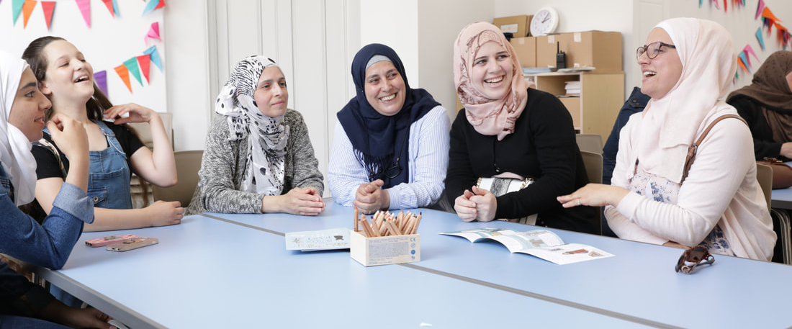
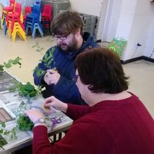
What can be funded/what is it for?
What is it for?
Projects and activities supporting vulnerable people in the District to enjoy community life and be included.
This could include, services to support vulnerable families (e.g. life skills, food banks) and activities which reduce isolation and increase social and emotional well-being (e.g. sports, arts, music, outdoor activities or social groups).
Notes:
NW

Slide 7
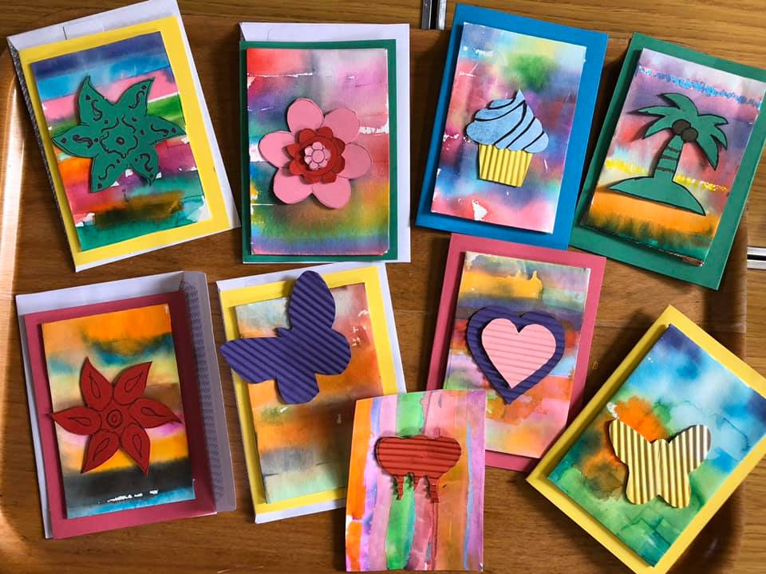
Previous recipients of SADC Grants
Salaam Women’s Café
Salaam Women’s Café provide a safe,
welcoming space for women from ethnic
minority backgrounds to come and
socialise, make crafts and learn English.
Awarded £1,023
Notes:
NW

Slide 8
Herts Musical Memories
Run “singing for memory” a Herts Musical Memories project providing singing lessons for people living with dementia and their carers.
Awarded £4000
H’arts in Mind
Deliver H’arts Art Friendship Activities for Well-being on-line Art for relaxation sessions, a friendship group and summer outing for people with physical or mental health challenges
Awarded £4,852
Notes:
NW

Slide 9
Key points
Service users/ beneficiaries should be involved in the planning and design of the project wherever possible
Did they write it, help to put the project together?
Projects and activities can be time limited
For example, over a school holiday or can run over a longer period
Projects can be for a small number of vulnerable people or a bigger group.
The important thing is to evidence the difference it will make to beneficiaries
Notes:
NW

Slide 10
The application form- Key Questions

Slide 11
Q 9b- Service user involvement in writing application
Volunteers and service users took part in a survey to
choose what activities they would like to take part in as part of the project.
How have your service users/ beneficiaries been involved in making this application?
How have they shaped the proposed project?
Have they helped to write the application?
The Users Committee came to us with a problem they wanted to fix and we shaped the project around it
“I really liked completing the application form and learned a lot. I’d like to do more in the future”
A long standing service user helped to complete the application, whilst another was able to put together a draft budget with support of the Treasurer.
Notes:
IH

Slide 12
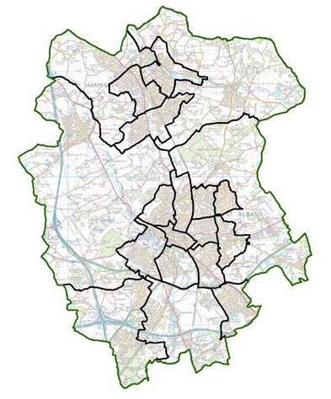
Question 10 and 11-
your projects beneficiaries
Who are the beneficiaries and where are they from? Why do SADC need to know who the project is for?
It is helpful for SADC to know who is benefitting from the grant in the District. This can help us understand where there are gaps in our funding and to make sure everyone has equal opportunity to participate in community life
 | Tick here | Approximate number and further details (if known)
People with disabilities
Physical disability | ☒ | 15 people – all with a mobility difficulty
Learning Disability/Difficulty | ☒ | 7 people
Hearing or sight impairment | □
Autism | □
Notes:
PS

Slide 13
Q12 Local decision making
The project provides a valuable opportunity for people to voice their challenges and unmet needs.
We would engage people in commissioning the services they need or presenting their needs to CCGS and others who may be able to support future projects and training.
Examples of good answers
We consult the community for feedback and future direction of the project/ regular planning meetings where everyone is welcome to attend and have their say.
We maintain close links with ward councillors, residents associations, schools and faith groups.
Ward councillors will be encouraged to attend our events, and we intend to have an annual event and invite the Mayor.
We will ensure the management groups are aware of SADC wellbeing strategy and the wellbeing boards aspirations and how they can engage in local decision making to enhance and shape those goals.
Notes:
PS

Slide 14
Question 13- Impact (Changes)
Examples of good answers
Change - Older people are aware of services and activities that they previously did not know about
What will you do to achieve this- We will include a broad cross section of organisations offering activities and services to older people with a requirement that all are accessible by phone
How will you measure it- We will use qualitative and quantitative data from feedback from recipients and partner organisations whose information we include to report on the impact of the project.
Change - 85 people will have the opportunity to be involved with their community.
What will you do to achieve this- By enabling the service users to meet their friends through one to one opportunities and enabling them to access the activities and the club safely.
How will you measure it- By talking to the service users and carers, questionnaires and how many people are accessing the activities.
Notes:
IH

Slide 15
Question 18– Safeguarding
Examples of good answers
If someone makes an allegation or disclosure of abuse the scheme will follow the Hertfordshire County Councils SAFA, Safeguarding Adults from Abuse
We have comprehensive and well-established safeguarding policies and procedures. These include clear protocols and systems in place for our staff and team should we identify that a person is at risk or in danger of significant harm.
If a volunteer is told something they have concerns about they are encouraged to inform the co-ordinator who will escalate the matter to the Named Person within the organisation, who will if needed contact HCC Safeguarding Board.
We have clear processes in place for referring any potential child protection issues to the relevant authorities, and all of our Trustees and key staff members have undertaken an enhanced DBS and safeguarding training
Notes:
IH

Slide 16
Question 17 – Equality and Inclusion
Examples of good answers
We provide the opportunity for individuals of all abilities, of all faiths, race, gender, age, disability, religion and sexual orientation to take part. We promote the events across all groups in the district.
We work closely with referrers to ensure that our service can support when needed and there is no discrimination
We reduce isolation of individuals with a disability/additional needs. This includes providing the opportunity for people to meet each other and to make friends and support each other too.
We ensure venues are accessible and near to public transport links and encourage parents/carers to bring the individuals where possible so everyone is included.
As part of the ethos of the events across the entire group of participants, coaches, volunteers, parents, carers, friends, siblings, we talk at the beginning of the event and at the end about respect and understanding people’s differences.
We have an inclusion, equality and diversity forum
We do not charge for any of our services, which keeps them open and accessible to all, regardless of background.
Notes:
PS

Slide 17
Your budget
Minibus Hire 3 days (£100 per day) £300.00
Petrol 3 Trips of 20 miles @45p per mile) £ 27.00
Volunteer Driver – 3 days (worth £300) £ 0.00
15 Adults entrance to Zoo (15 x 10) £150.00
15 Adults entrance to pier (15 x £2) £ 30.00
15 Adults talk at museum (15 x £4) £ 60.00
Carers on 3 trips (negotiated - free) £ 0.00
Meal at café paid for by members £ 0.00
Volunteer escorts – 10 x 6 hours x 3days (worth £2000) £ 0.00
Volunteer organiser – 50 hours (worth £600) £ 0.00
_______
Total Cost £ 567.00
This must be a separate document
Projects need to demonstrate value for money.
List all the individual costs associated with the project and you must total the costs.
Grants may only be awarded for part of the requested amount. Please cost up your project, rather than trying to make your project fit the grant amount.
Don’t just apply for £5,000
Notes:
NW

Slide 18
Financial information
Accounts including a Balance Sheet & Income & Expenditure account (for 2 years where possible)
If accounts are over 9 months old, a Trading Statement or Management Accounts for the period since the last set of accounts bringing the position as up to date as possible.
A budget looking forward into the period in which the grant funding will be spent.
If the above, particularly 1&2 is a serious challenge for very small organisations bank statements may be acceptable if they show a pattern of sustainability.
Clarity & quality of information is most important. Avoid items in accounts with a description of ‘Other’. The more detail that can be presented helps save time with the process and enhances transparency.
Notes:
NW

Slide 19
Getting help
Communities 1st Advice Surgeries
1. Read SADC’s Guidance document & Inclusion strategy and follow carefully
2. Review SADC’s priorities versus your aims
3. Attend an open ZOOM Advice Surgery
4. Start writing your application early
5. Have a clear project plan
6. Cost your budget , don’t just apply for £5k
More groups have successful applications if they work with C1st first!
Notes:
IH

Slide 20
Getting help
Communities 1st Advice Surgeries
To discuss project ideas, how to fill in the form in detail and will ideas e.g. evidence of need
Completed draft applications should be emailed in advance to StAlbansGrants@communities1st.org.uk.
Communities 1st will offer some guidance for improvement
Advice Surgery dates:
Thursday 15 June 2pm
Wednesday 21 June 4pm
Tuesday 27 June 3pm
Notes:
IH

Slide 21
Summary
Service users/ beneficiaries should be involved in the planning and design of the project
Grants will be between £500-£5000
Community Project Fund
Two rounds opening in June and November 2023
Meet the funding criteria
Projects can be for a small number of vulnerable people or a bigger group
Have specific, realistic and deliverable outcomes which will meet an identified evidenced need
Demonstrate how they contribute to the Equality, Diversity & Inclusion Strategy
Projects and activities can be time limited
Projects and activities supporting vulnerable people in the District
Notes:
PS

Slide 22
Timetable
Community Project Fund
2022/23 Community Project Fund open | Wednesday 1 June 2023 | Monday 17th May 2021
Advice Workshops | Thursday 15 June 2pm Wednesday 21 June 4pm Tuesday 27 June 3pm | Tuesday 25th May between 2.30pm Weds 16th June between 1.00 pm Friday 2nd July between 10.30am – 12.00pm www.communities1st.org.uk/calendar/month
Closing date for applications | Midnight Thursday 20 July 2023 Send to:StAlbansGrants@communities1st.org.uk | Midday on Friday 31st July Send to: cgf@communities1st.org.uk
Decision process: scoring of applications by Community Engagement officers, input from Communities 1st and officers from relevant SADC departments (including finance), recommendations presented to Grants Panel
Notification of Grants awarded |  | By End August 2023
Notes:
PS

Slide 23
Thank you for attending! Any questions? Closing date for Community Project Fund applications Midnight Thursday 20 July 2023
Notes:
PS

