Slide 1
Presented by
Phil Wright
Presented to
The Good Causes of
St Albans District

Slide 2
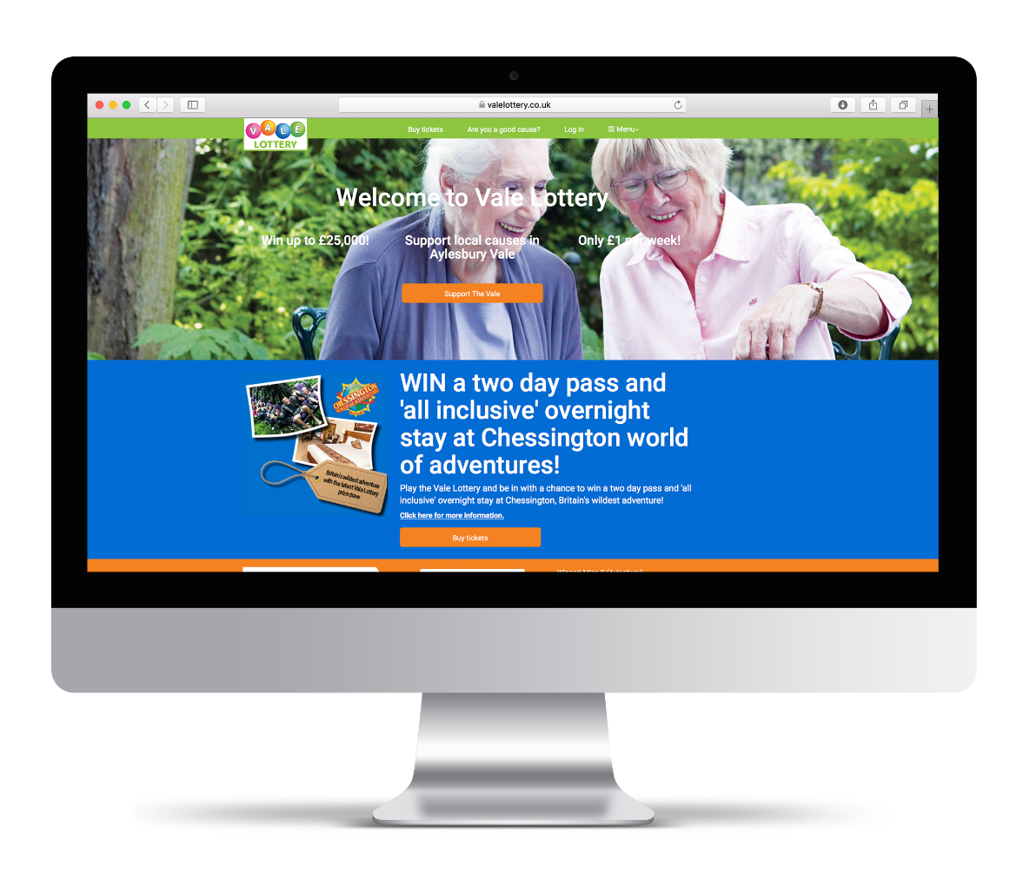
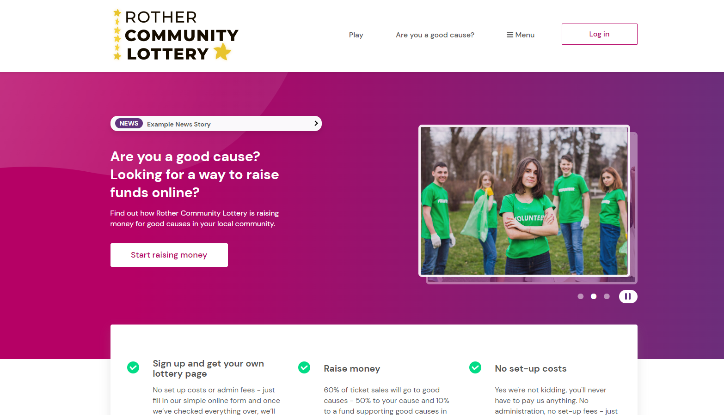
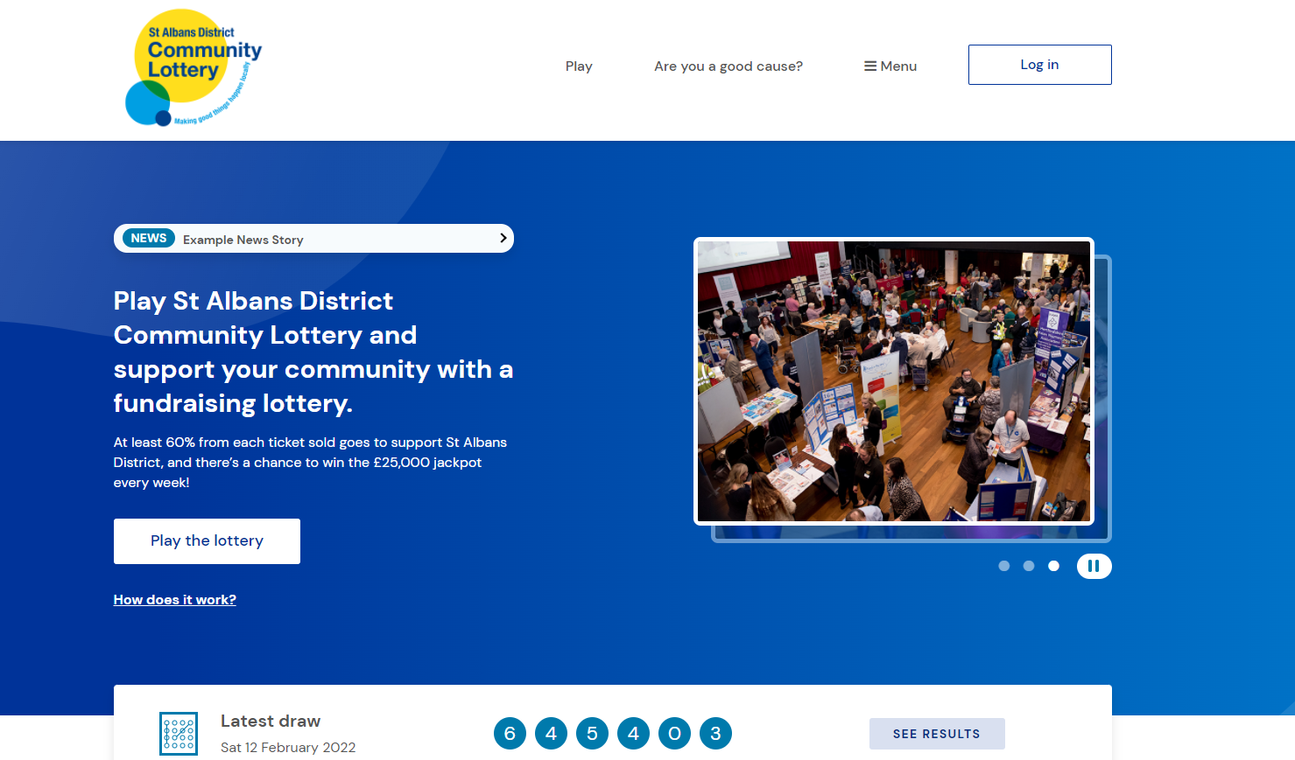
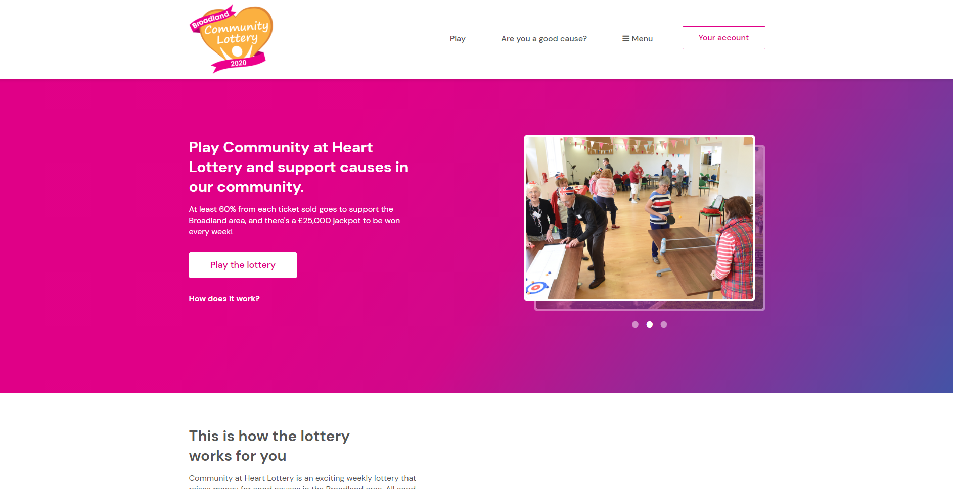
Introducing your new Lottery
St Albans District Community Lottery is a new initiative from St Albans District Council
Powered by expertise from Gatherwell Ltd an established External Lottery Management Company
The lottery is being launched to support good causes locally

Slide 3
How it works
How it works for supporters
Splitting the pound
Prizes
How it works for good causes
Good cause support
Your commitment

Slide 4
How the lottery works
How it works
Supporters
Winning
Visit the site
(www.StAlbansDistrictLottery.co.uk)
Winners will be notified via email and are paid directly into a nominated account or they can donate their winnings to the good cause.
Weekly online lottery with a draw every Saturday at 8pm. The more numbers you match the bigger the prize!
£1
Payments
Tickets - £1 a week
Supporters can pay by Direct Debit or payment card. Either a monthly recurring payment or a 1/3/6/12 month payment upfront.
Each ticket costs £1 per week and consists of 6 numbers. Players can choose numbers or a lucky dip.
Choose a cause
Each ticket can either support the Central Fund (many causes) or a specific good cause listed on the site.

Slide 5
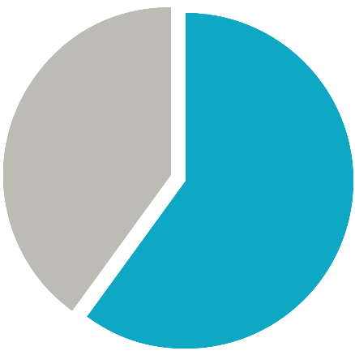
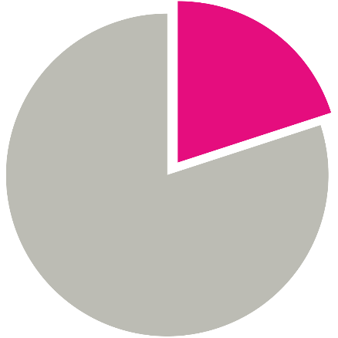
Splitting the pound
60%
20%
20%
Good causes
Prizes
Running costs & VAT
60% of all tickets sales goes to good causes!
50% to the individual cause selling the ticket + 10% to the central fund
20% of tickets sales goes back to supporters as prizes
The running costs incurred by Gatherwell. These include the costs of all banking and transaction fees, running the site, player support, marketing and VAT

Slide 6
Prizes
Number of matches
Matching patterns
Odds
Prizes
6
NNNNNN
1,000,000:1
£25,000*
Odds of winning a prize are 1 in 50
5
NNNNNn or nNNNNN
55,556:1
£2,000
4
NNNNnn or nnNNNN
5,556:1
£250
3
NNNnnn or nnnNNN
556:1
£25
2
NNnnnn or nnnnNN
56:1
3 free tickets
N is a match, n is not. So NNNNNN is 6 matches and nnnnnn is no matches
*The jackpot prize is underwritten by prize insurance common place in the industry and can be paid out irrelevant of the size of the lottery. Should multiple winners be lucky enough to match the winning combination all winners will each win the jackpot prize.

Slide 7
Bolt-On prizes
There will also be seasonal national bolt on prizes throughout the year, these will be in addition to the regular draw to encourage new players to enter and to reward existing supporters

Slide 8
How the lottery works
£
How it works
Causes
Visit the site www.StAlbansDistrictLottery.co.uk
Raise Funds
Every month the cause will get their raised funds paid directly into their nominated account!
The cause will visit the website and go to the fundraisers section where they can find out more and apply to join.
• There is no cost to the good cause
• They can be raising money within 1-2 days!
Market to Supporters
Apply to Join
Now Live on the site all the cause needs to do is market to their supporters.
Applying is easy. It’s done online and takes a few minutes.
Get Approved
The LA will check the causes qualifies and approve them. Once approved they’ll have their own page and welcome pack in 1-2 days!

Slide 9
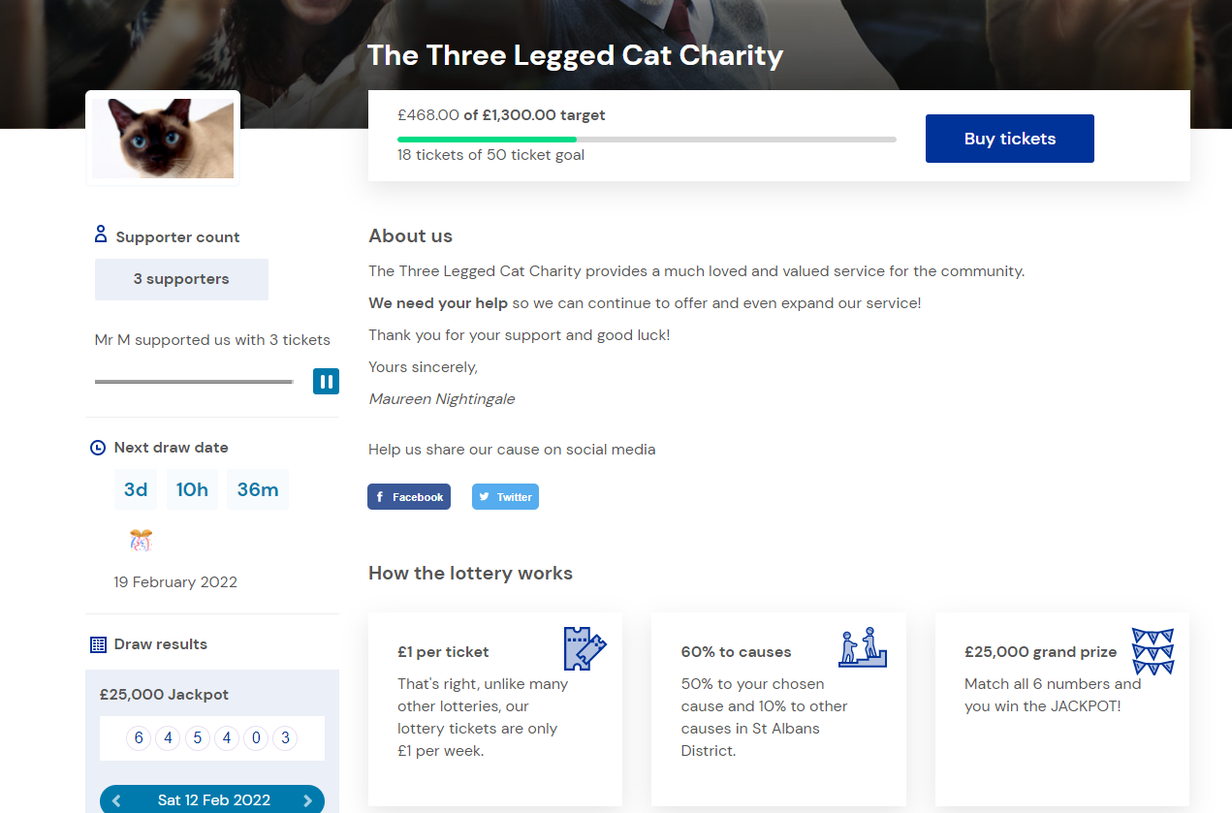
Good cause webpage

Slide 10
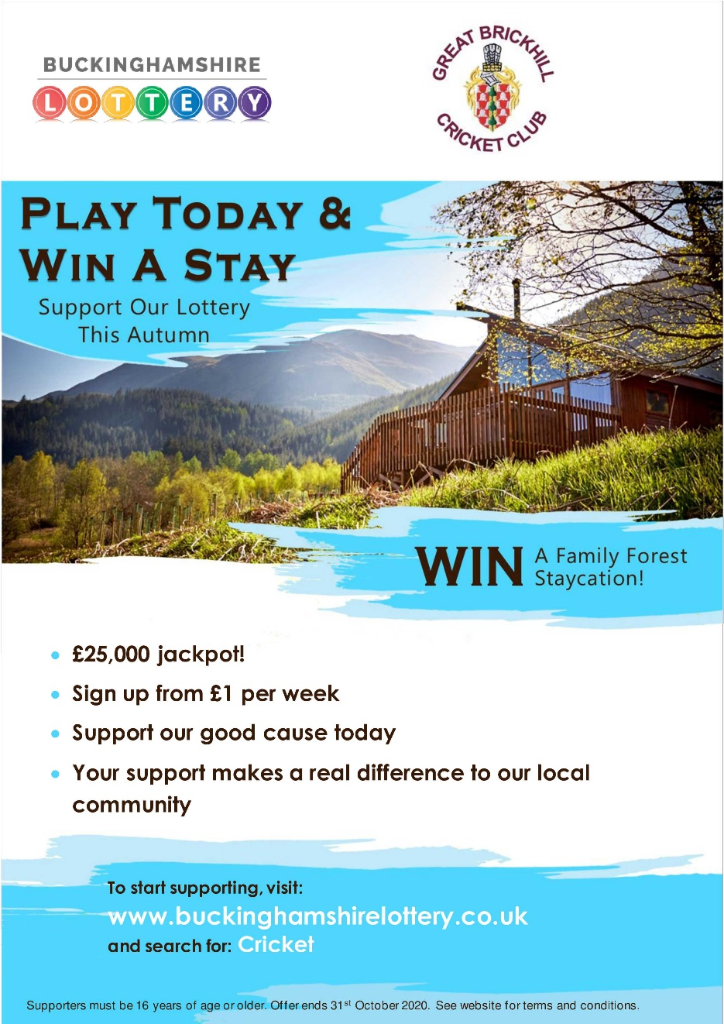
Lottery Logo
Bespoke marketing materials
Good Cause Logo
Motivating Headline
Seasonally Relevant
Explanation of how it works
Easy Search Term

Slide 11
Good cause dashboard

Slide 12
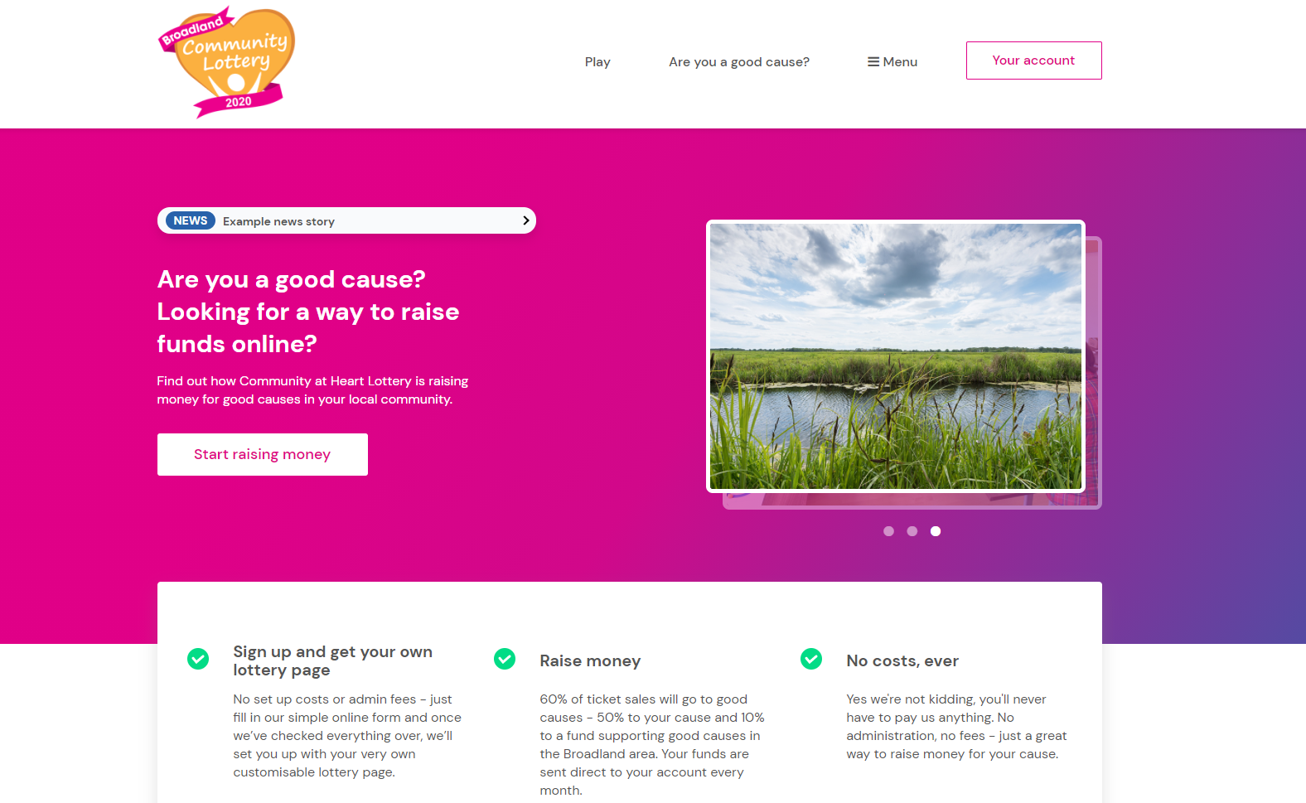
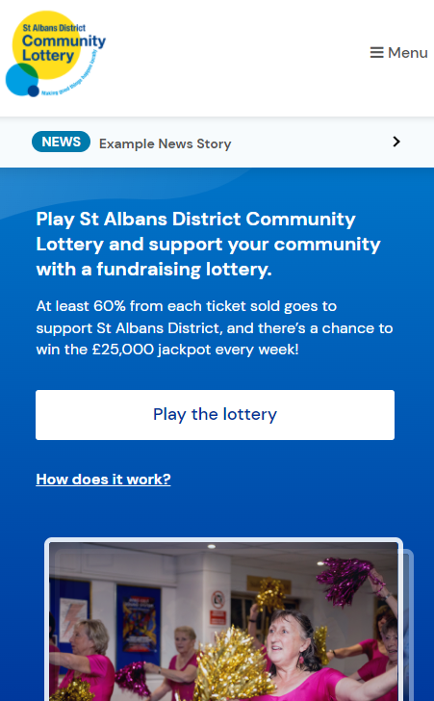
Website
www.StAlbansDistrictLottery.co.uk
• Bespoke website designed in partnership with the council
• Powered by the Gatherwell engine
Regularly updated with new features to keep up with the latest technology and improve player acquisition and retention
• Fully secure, PCI compliant site
• 99% uptime SLA, monitored 24/7
• Responsive website
Viewable on all devices (mobile, tablet and desktop)

Slide 13
Support for Causes and Supporters
Dedicated telephone number 01727 304020
for your supporters and good causes – answered as your lottery
Dedicated email address support@stalbansdistrictlottery.co.uk
Dedicated social media accounts managed by Gatherwell (Facebook and Twitter) for posting results and increasingly direct communication with customers

Slide 14
Process for assessing applicable Good Causes
What’s the role of the council?
Central marketing and promotion of the lottery
Overall scheme administration
General good practice and advice
All the licencing and returns

Slide 15
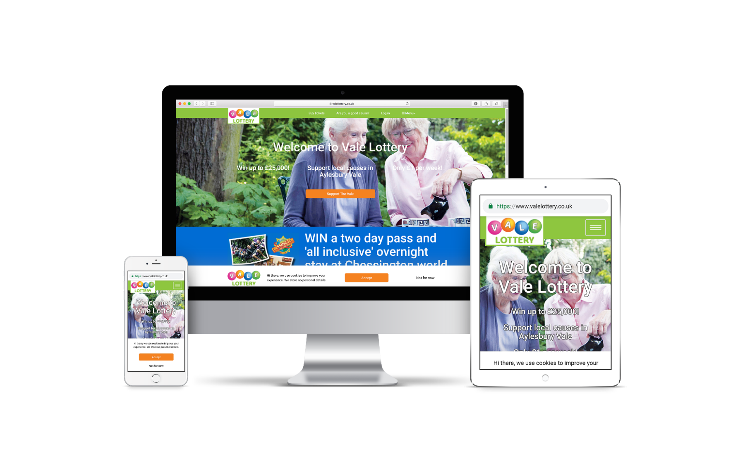
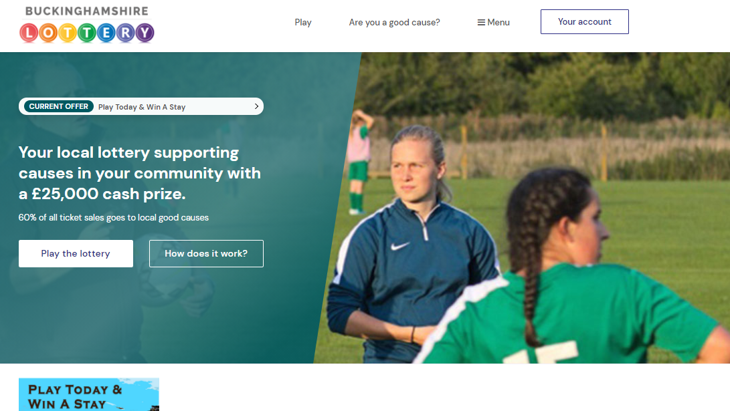
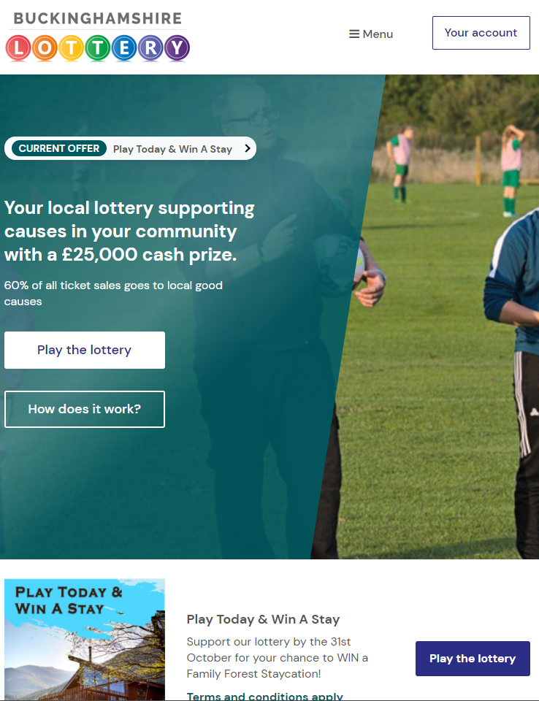
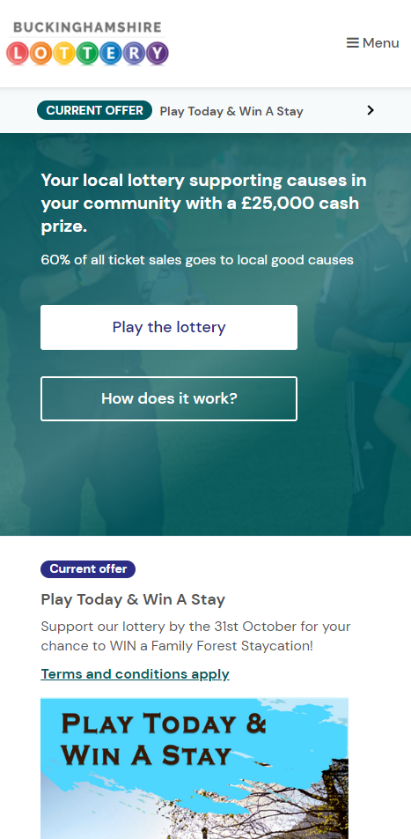
Vale Lottery – (Now Buckinghamshire Lottery)
Launched in November 2015. The Vale Lottery was the first online Local Authority Lottery in the UK
Created directly in response to the pressure on the community funds budgets and to help the Voluntary and Community Sector (VCS) gain access to new funding streams.
Track record
Incredible start – Over 40 causes signed up for the first draw. Coverage on BBC TV, radio and press.
Growing
Over 300 good causes now signed up for their own page, with money raised already going to support their work. Have raised nearly £600k for local good causes
Satisfied customers
Overwhelming customer satisfaction feedback from good causes and supporters.

Slide 16
Case Study – Great Brickhill Cricket Club
Aims
Great Brickhill Cricket Club provides top class cricket and coaching facilities for all ages, with over 100 juniors from 4 and upwards being taught how to play this great game.
Joined
Number of tickets
Raising
Planning to spend on
November 2015
93
£2,418 a year
Investing in junior coaching with their proceeds
Top Tip
Offered a ‘free drink’ from the bar for everyone who signed up to the lottery before the first draw

Slide 17
Case Study – Carers Bucks
Aims
Carers Bucks is an independent charity which supports the wellbeing of unpaid family carers living in Buckinghamshire
Joined
Number of tickets
Raising
Planning to spend on
November 2015
38
£988 a year
Now running a new support group with their proceeds
Top Tip
Added the lottery link to their page of all their email signatures

Slide 18
Case Study – Medical Detection Dogs
Aims
The Medical Alert Assistance Dogs are trained to assist individuals who manage complex medical conditions, such as diabetes, on a day-to-day basis. The dogs are taught to identify the odour changes that are emitted prior to an emergency and alert the person to take preventative action.
Joined
Number of tickets
Raising
Planning to spend on
November 2015
94
£2,444 a year
Training new dogs to support Type 1 Diabetics
Top Tip
Added link to the website and regularly post on social media

Slide 19
Case Study – Brill Sports & Social Club
Aims
Brill Sports & Social Club aim to promote participation in sport in and around the village. They provide support for their teams of football, cricket and touch rugby as well as sections for tennis, table tennis and Aunt Sally.
Joined
Number of tickets
Raising
Planning to spend on
November 2015
43
£1,118 a year
Investing in club premises and equipment
Top Tip
Leaflet dropped the village

Slide 20
Our Commitment
We want to make it as easy as possible for you to succeed. Signing up means you get:
Your own dedicated webpage on the Lottery website
Bespoke marketing materials co-branded with your cause
A dashboard so you can see how you’re doing and who’s supporting you
A welcome pack with all the information you need on how to build participation
Weekly update emails with your latest stats and the latest communication materials
PLUS Your cause get 50% of every ticket sold from your page – Paid straight into your nominated bank account every month!

Slide 21
Your Commitment
Sell 20 tickets within 4 weeks of your cause going live
Staffed email address(es)
Use your dashboard
Track your own performance
Use of the dedicated marketing material
Upload bank details so we can pay you
Keep your cause message updated – tell your supporters how their money is helping
Help us help you!
Spread the word!

Slide 22
Key dates
23rd
April
First Draw
TODAY
Good Cause Launch
22nd March Tickets open to players

Slide 23
Questions?

